Slide 1
TEAM WAVES
Round 2 submission

Slide 2
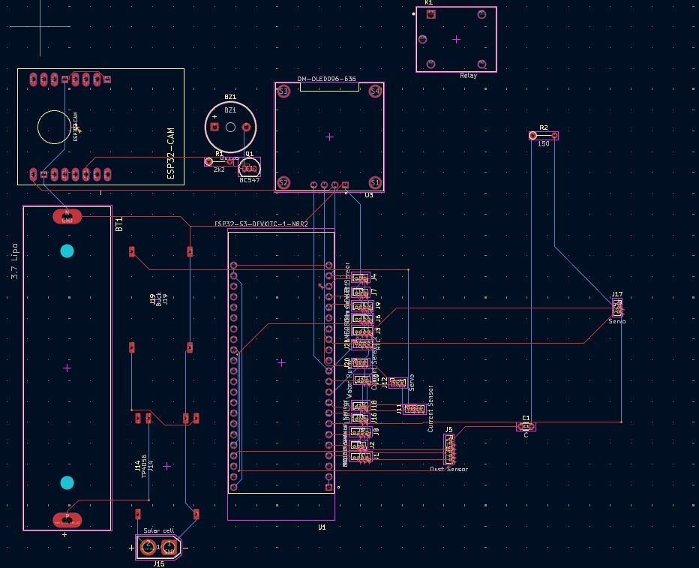
Design and Electrical Rule Checks:

Slide 3
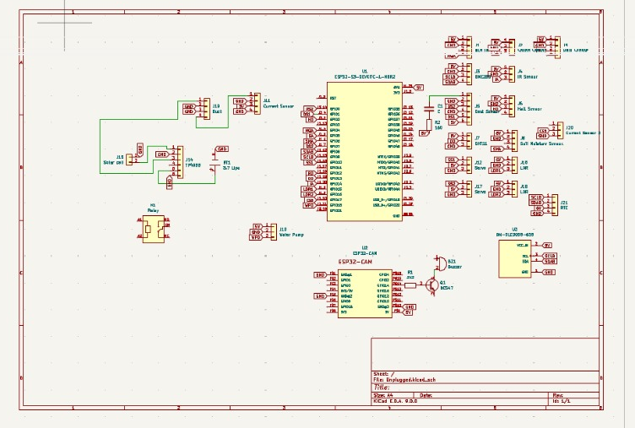
Pin Mapping and component placement:

Slide 4
No. of components used/ BOM:
Sr no. | Component | Quantity | Unit Price | Total Price
1 | ESP32 S3 Dev module | 1 | 1458 | 1458
2 | MQ-135 gas sensor | 1 | 106 | 106
3 | LM393 Sound detection sensor module | 1 | 48 | 48
4 | OLED Display | 1 | 440 | 440
5 | BME280 Environmental Sensor | 1 | 284 | 280
6 | Solar Panel | 2 | 48 | 96
7 | TP4056 (Rechargeable module) | 1 | 14 | 14
8 | IR Flame Sensor | 1 | 199 | 199
9 | LG MH1 Li-ion Battery 3.7V 2500mAh 18650 | 1 | 400 | 400
10 | Type-C 5V 2A Voltage step up boost converter | 1 | 58 | 58
11 | Dust Sensor | 1 | 473 | 473
12 | Hall Effect Sensor | 1 | 30 | 30

Slide 5
No. of components used/ BOM:
Sr no. | Component | Quantity | Unit Price | Total
13 | MAX471 Current and Voltage sensor | 1 | 299 | 299
14 | Water Flow Sensor | 1 | 171 | 171
15 | DHT11 Temperature and Humidity Sensor | 1 | 53 | 53
16 | Soil Moisture Sensor | 1 | 464 | 464
17 | Relay Module | 1 | 63 | 63
18 | Rain Sensor | 1 | 53 | 53
19 | RTC DS3231 module | 1 | 149 | 149
20 | ESP32 CAM | 1 | 300 | 300
21 | LDR | 2 | 6 | 12
22 | Servo MG90S | 2 | 113 | 226
Total : Rs. 5392

Slide 6
Overall Layout :
Overview of the Environment Monitoring System for a Smart City
The Environment Monitoring System is designed to collect real-time environmental data using multiple sensors and an ESP32-based architecture. The system ensures efficient monitoring of air quality,
weather conditions, and solar energy optimization, contributing to a smart and sustainable urban environment.
System Components & Functionality
Air Quality Monitoring
MQ-135 Gas Sensor: Detects air pollutants such as CO₂, NH₃, and NOx.
Dust Sensor: Measures particulate matter (PM2.5, PM10) levels in the air.
Weather & Environmental Data Collection
BME280 Sensor: Measures temperature, humidity, and barometric pressure.
DHT11 Sensor: Additional temperature and humidity monitoring.
Rain Sensor: Detects rainfall intensity.
Soil Moisture Sensor: Monitors soil humidity for smart irrigation.
Water Flow Sensor: Helps track water consumption or potential leaks.
Solar Energy Optimization
Adaptive Light-Dependent Solar Tracking System using:
LDRs (2 units): To track sunlight direction dynamically.
Servo Motors (MG90S, 2 units): Adjusts the solar panel's angle for maximum efficiency.
Solar Panel: Captures solar energy for power generation.
TP4056 Module & Li-ion Battery: Enables energy storage for uninterrupted operation.
4.Fire & Hazard Detection
IR Flame Sensor: Detects fire outbreaks in real-time.
Hall Effect Sensor: Can be used for magnetic field detection in smart safety applications.
5.Power & Communication
ESP32 S3 & ESP32-CAM: Handles data processing and transmission to a cloud/server.
RTC DS3231 Module: Provides real-time clock functionality for time-stamped data logging.
OLED Display: Displays live environmental readings.
6.Smart Control & Actuation
Relay Module: Can be used for automated switching of devices based on sensor data.
Type-C 5V 2A Boost Converter: Regulates power supply efficiently.

Slide 7
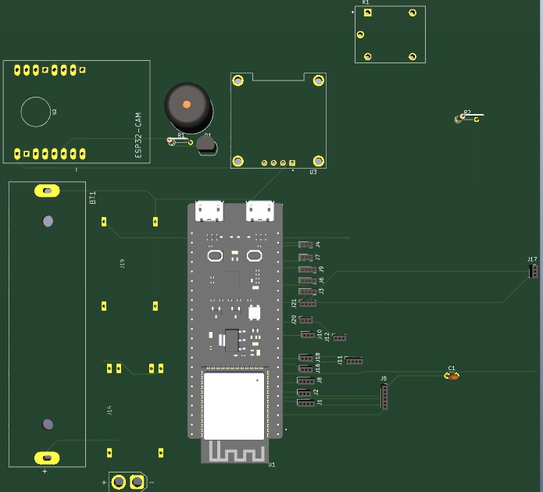
Final PCB:

Slide 8
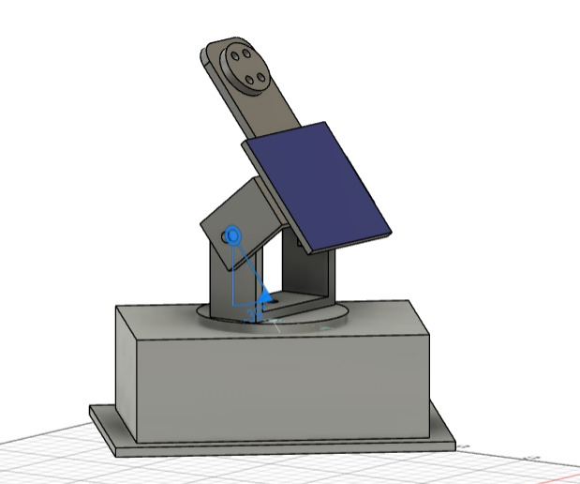
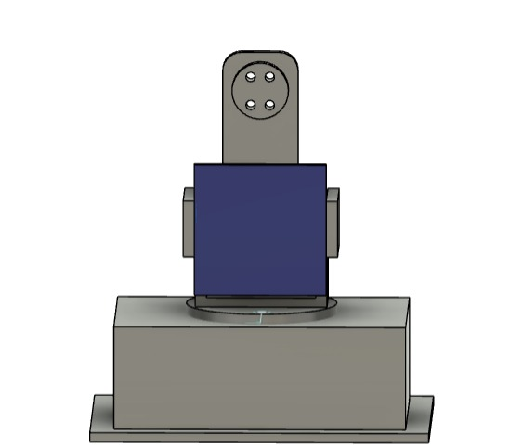
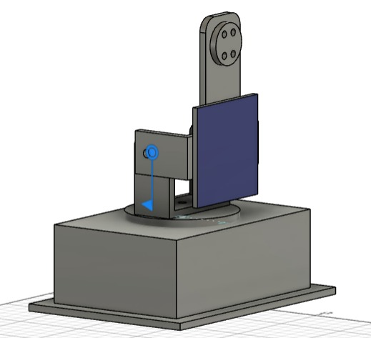
CAD:
Adaptive Light-Dependent Solar Tracking System

